Slide 1
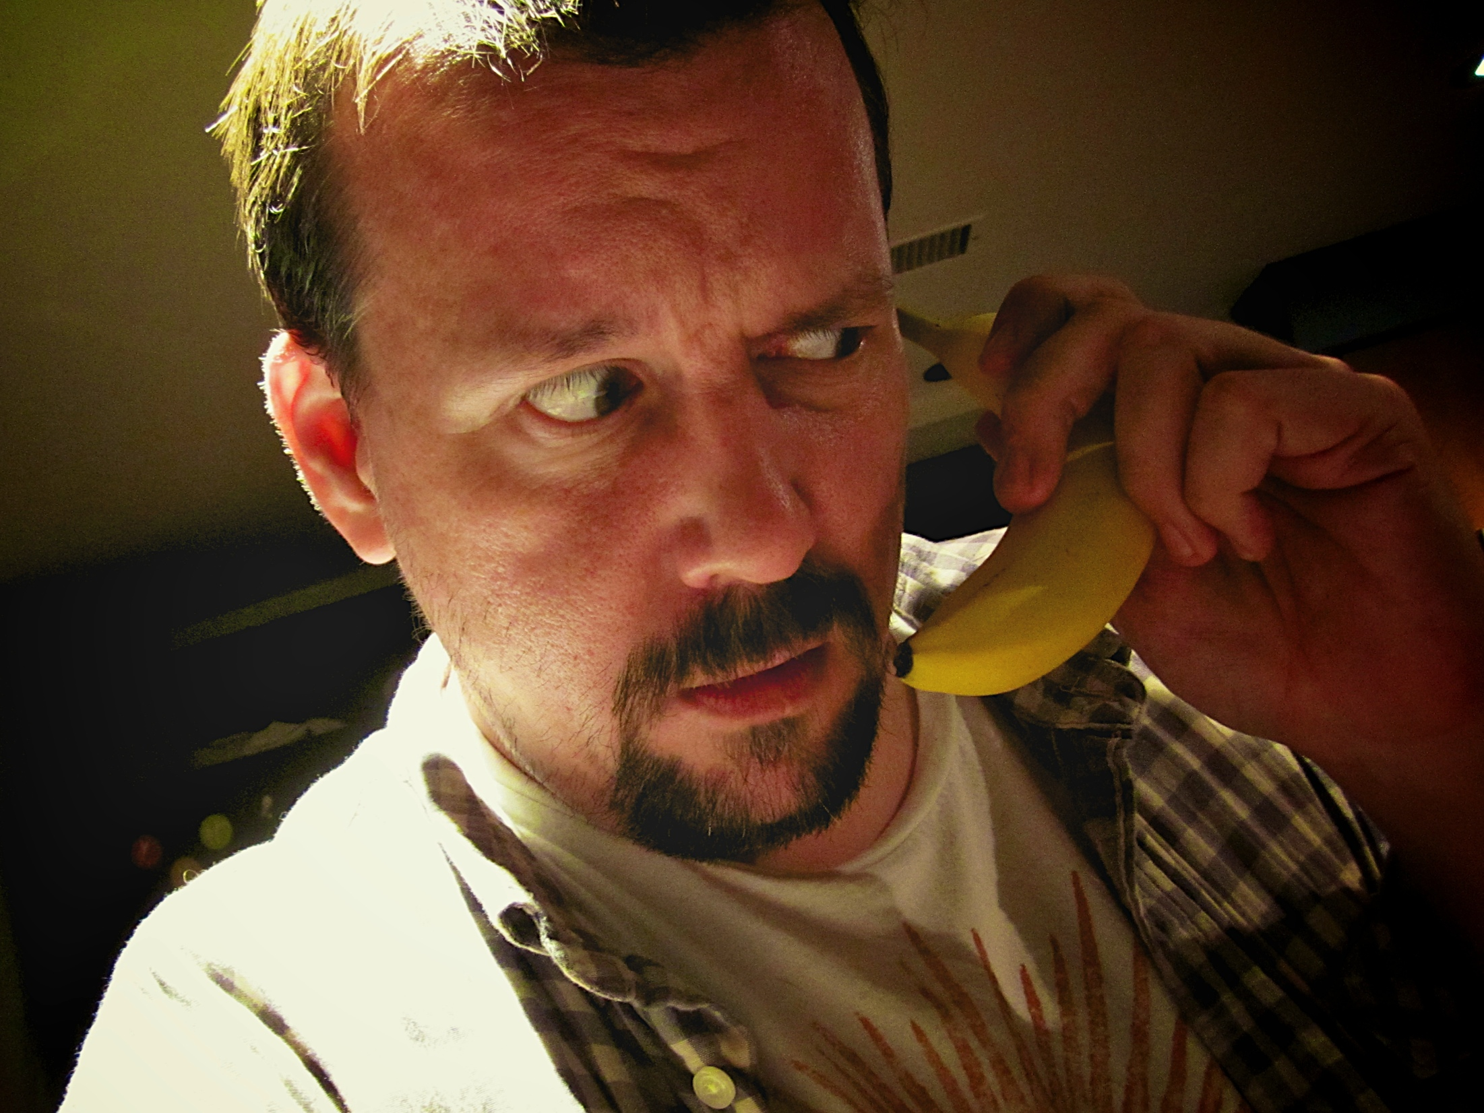


computational representations of pretend play
mikhail jacob justin permar eric fruchter justin smith matthew guzdial brian magerko mark riedl andrea thomaz

Slide 2

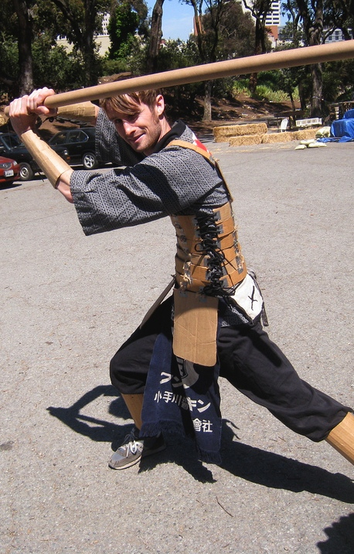
pretend play

Slide 3

playful behavior definition
empirical study of play
socio-cognitive pretend play model
playful agent architecture
playful behavior generation
real-time virtual environment play interaction
natural human agent / robot interaction
human robot turn-taking
computational play project

Slide 4
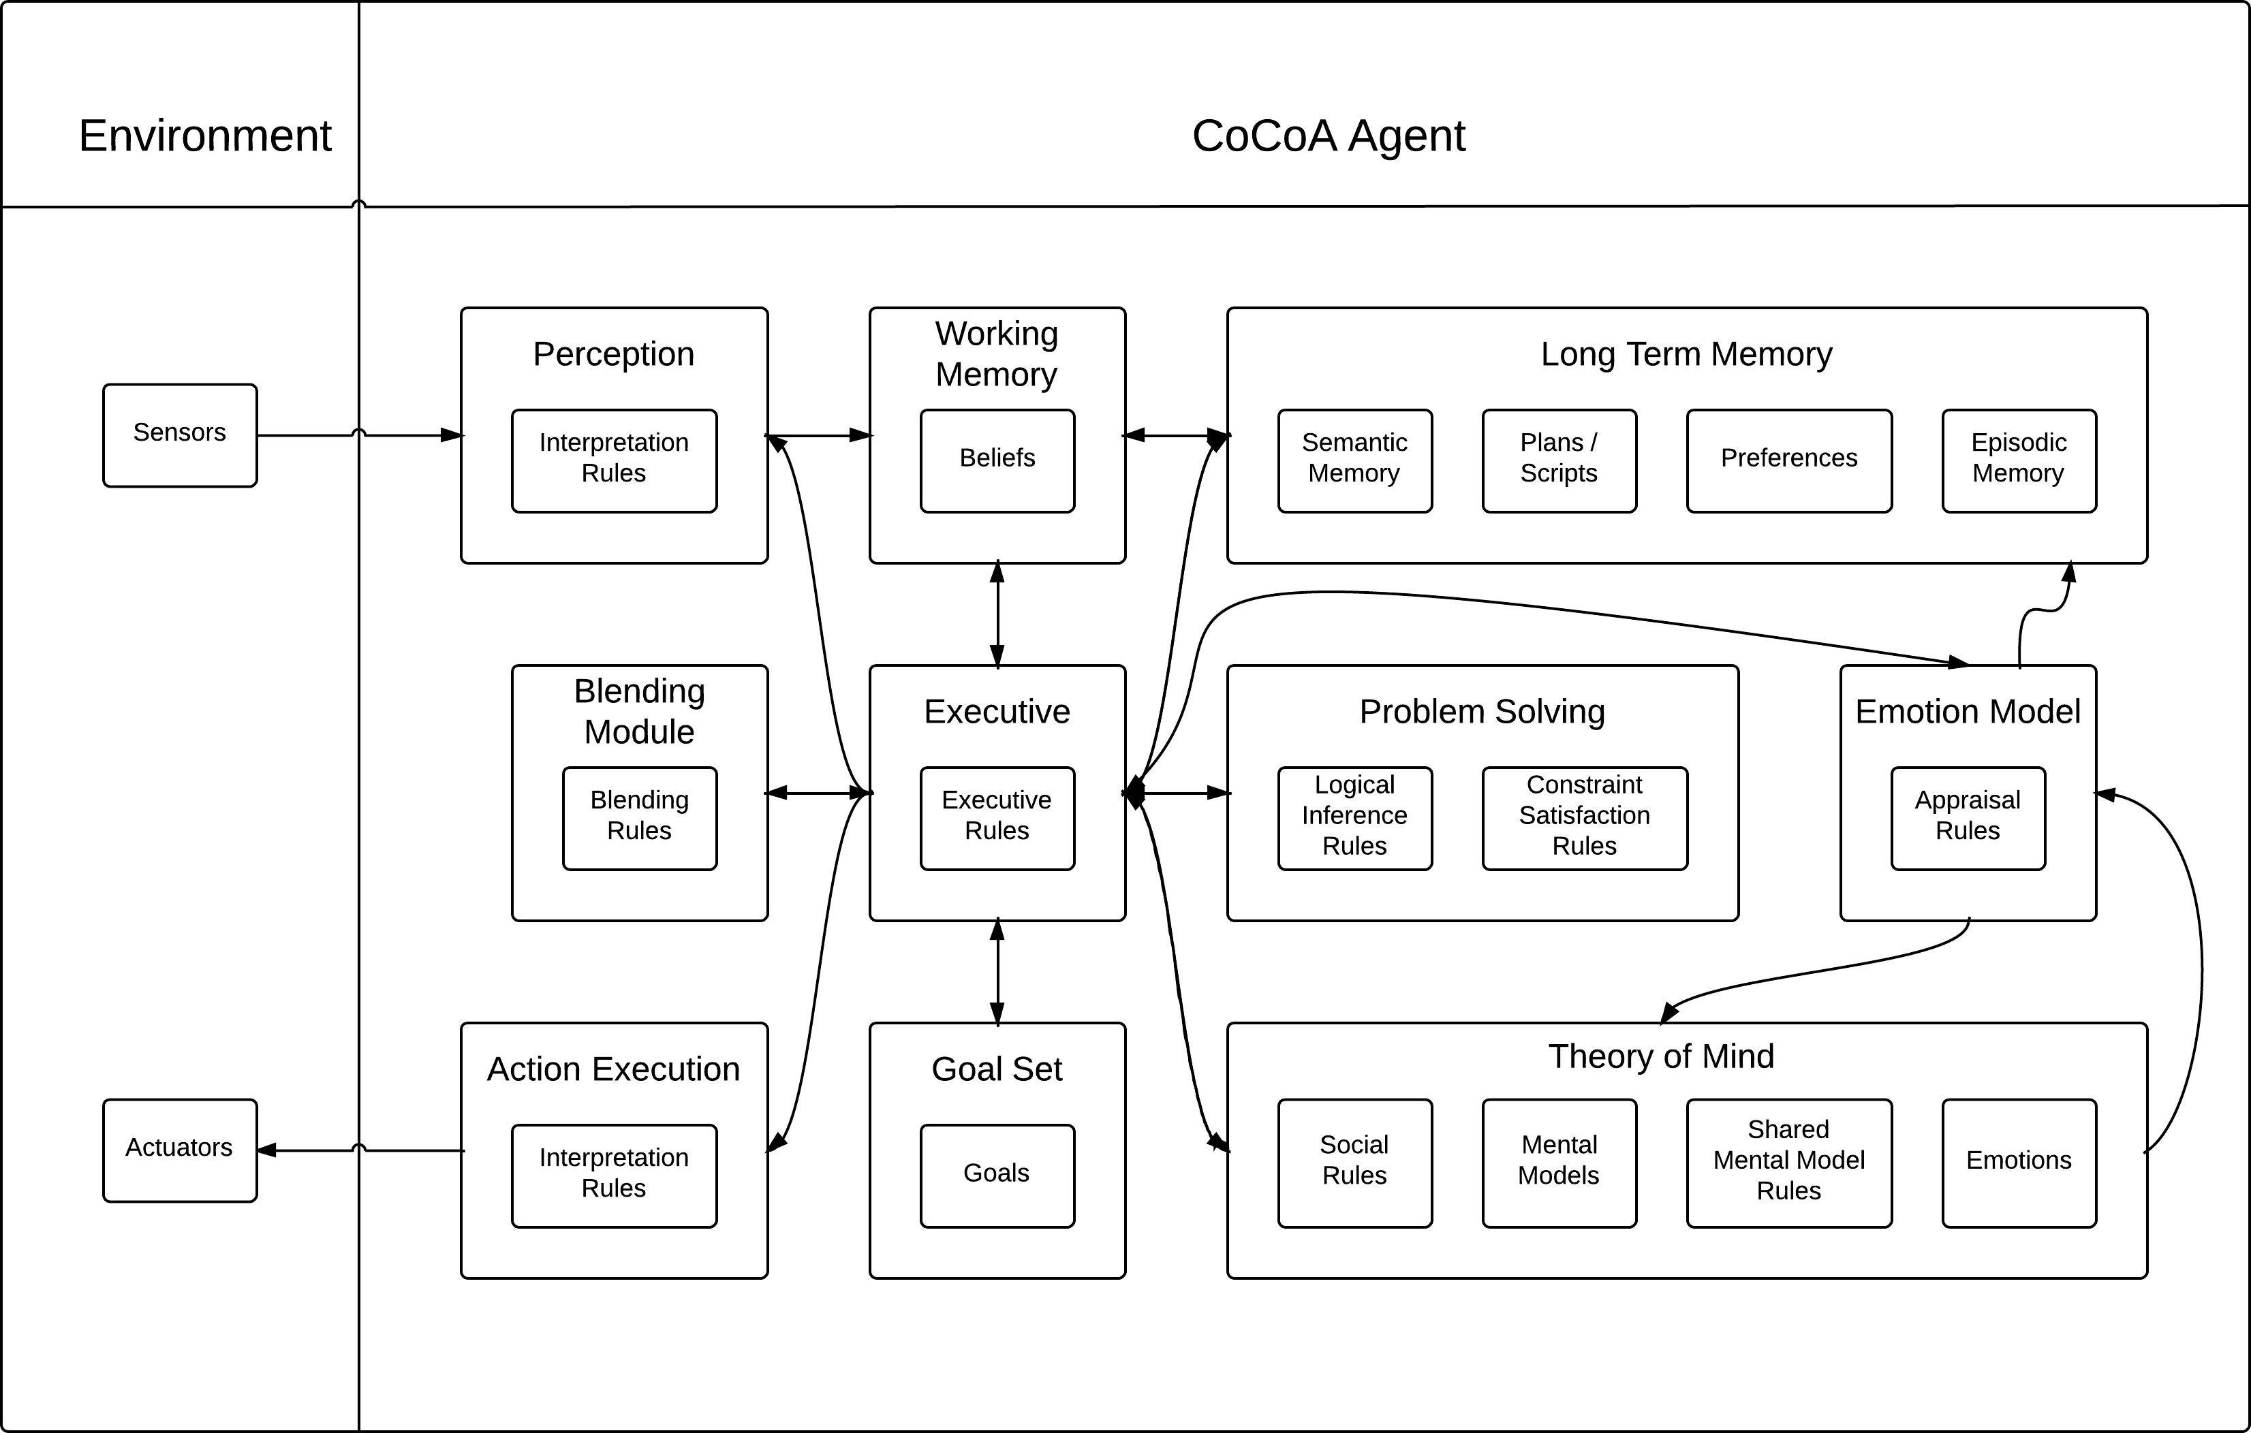
CoCoA (Co-creative Cognitive Architecture)

Slide 5
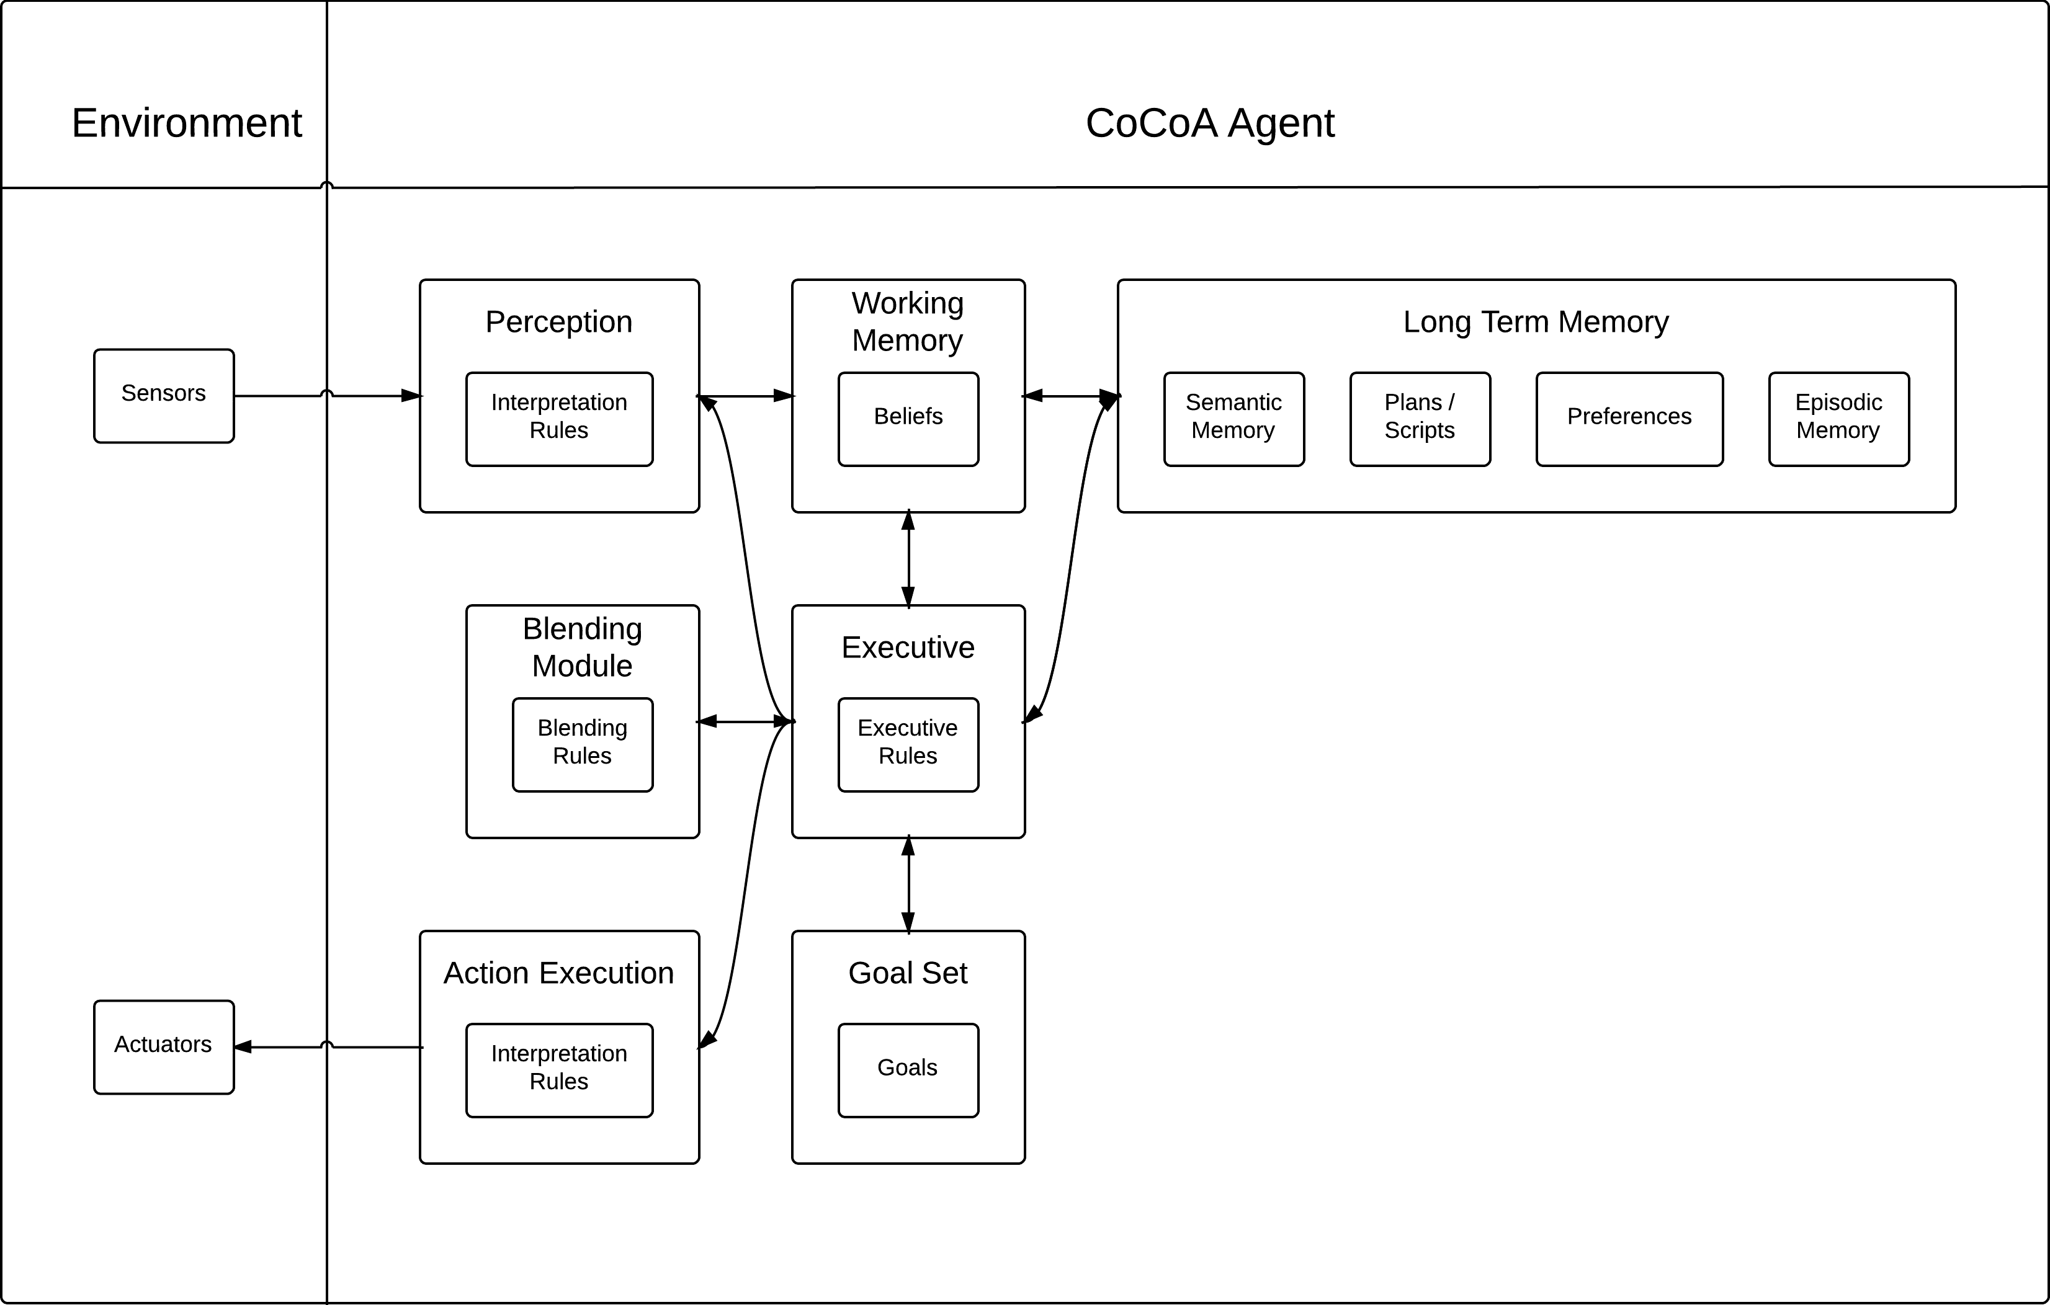
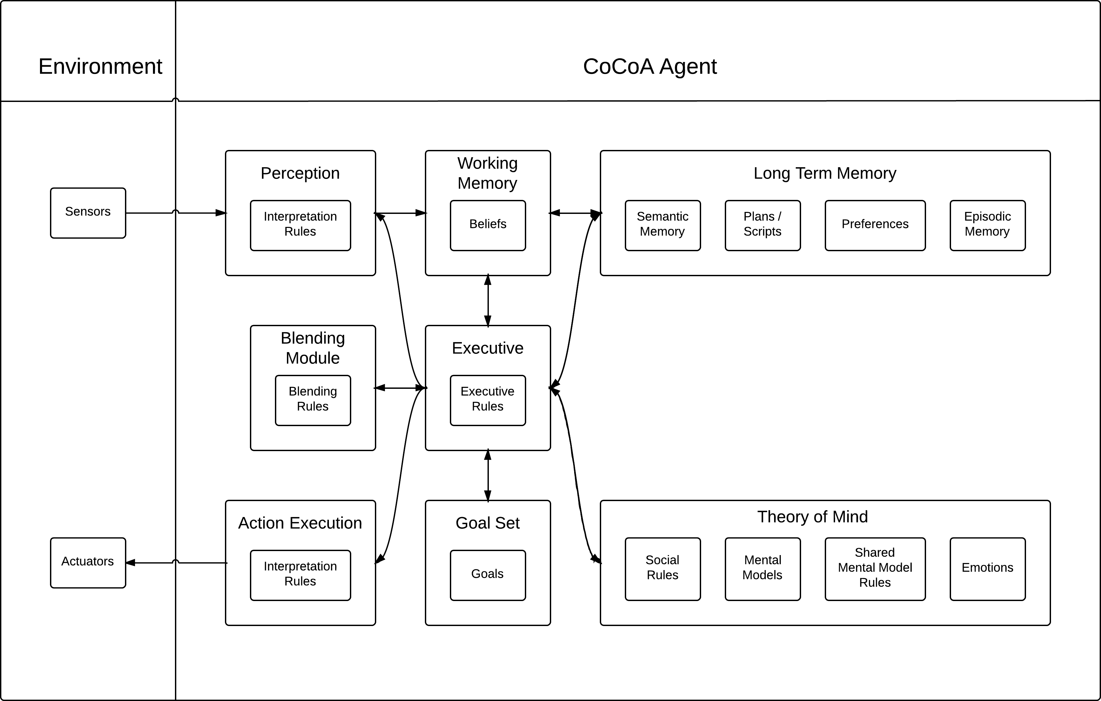
CoCoA in Soar

Slide 6


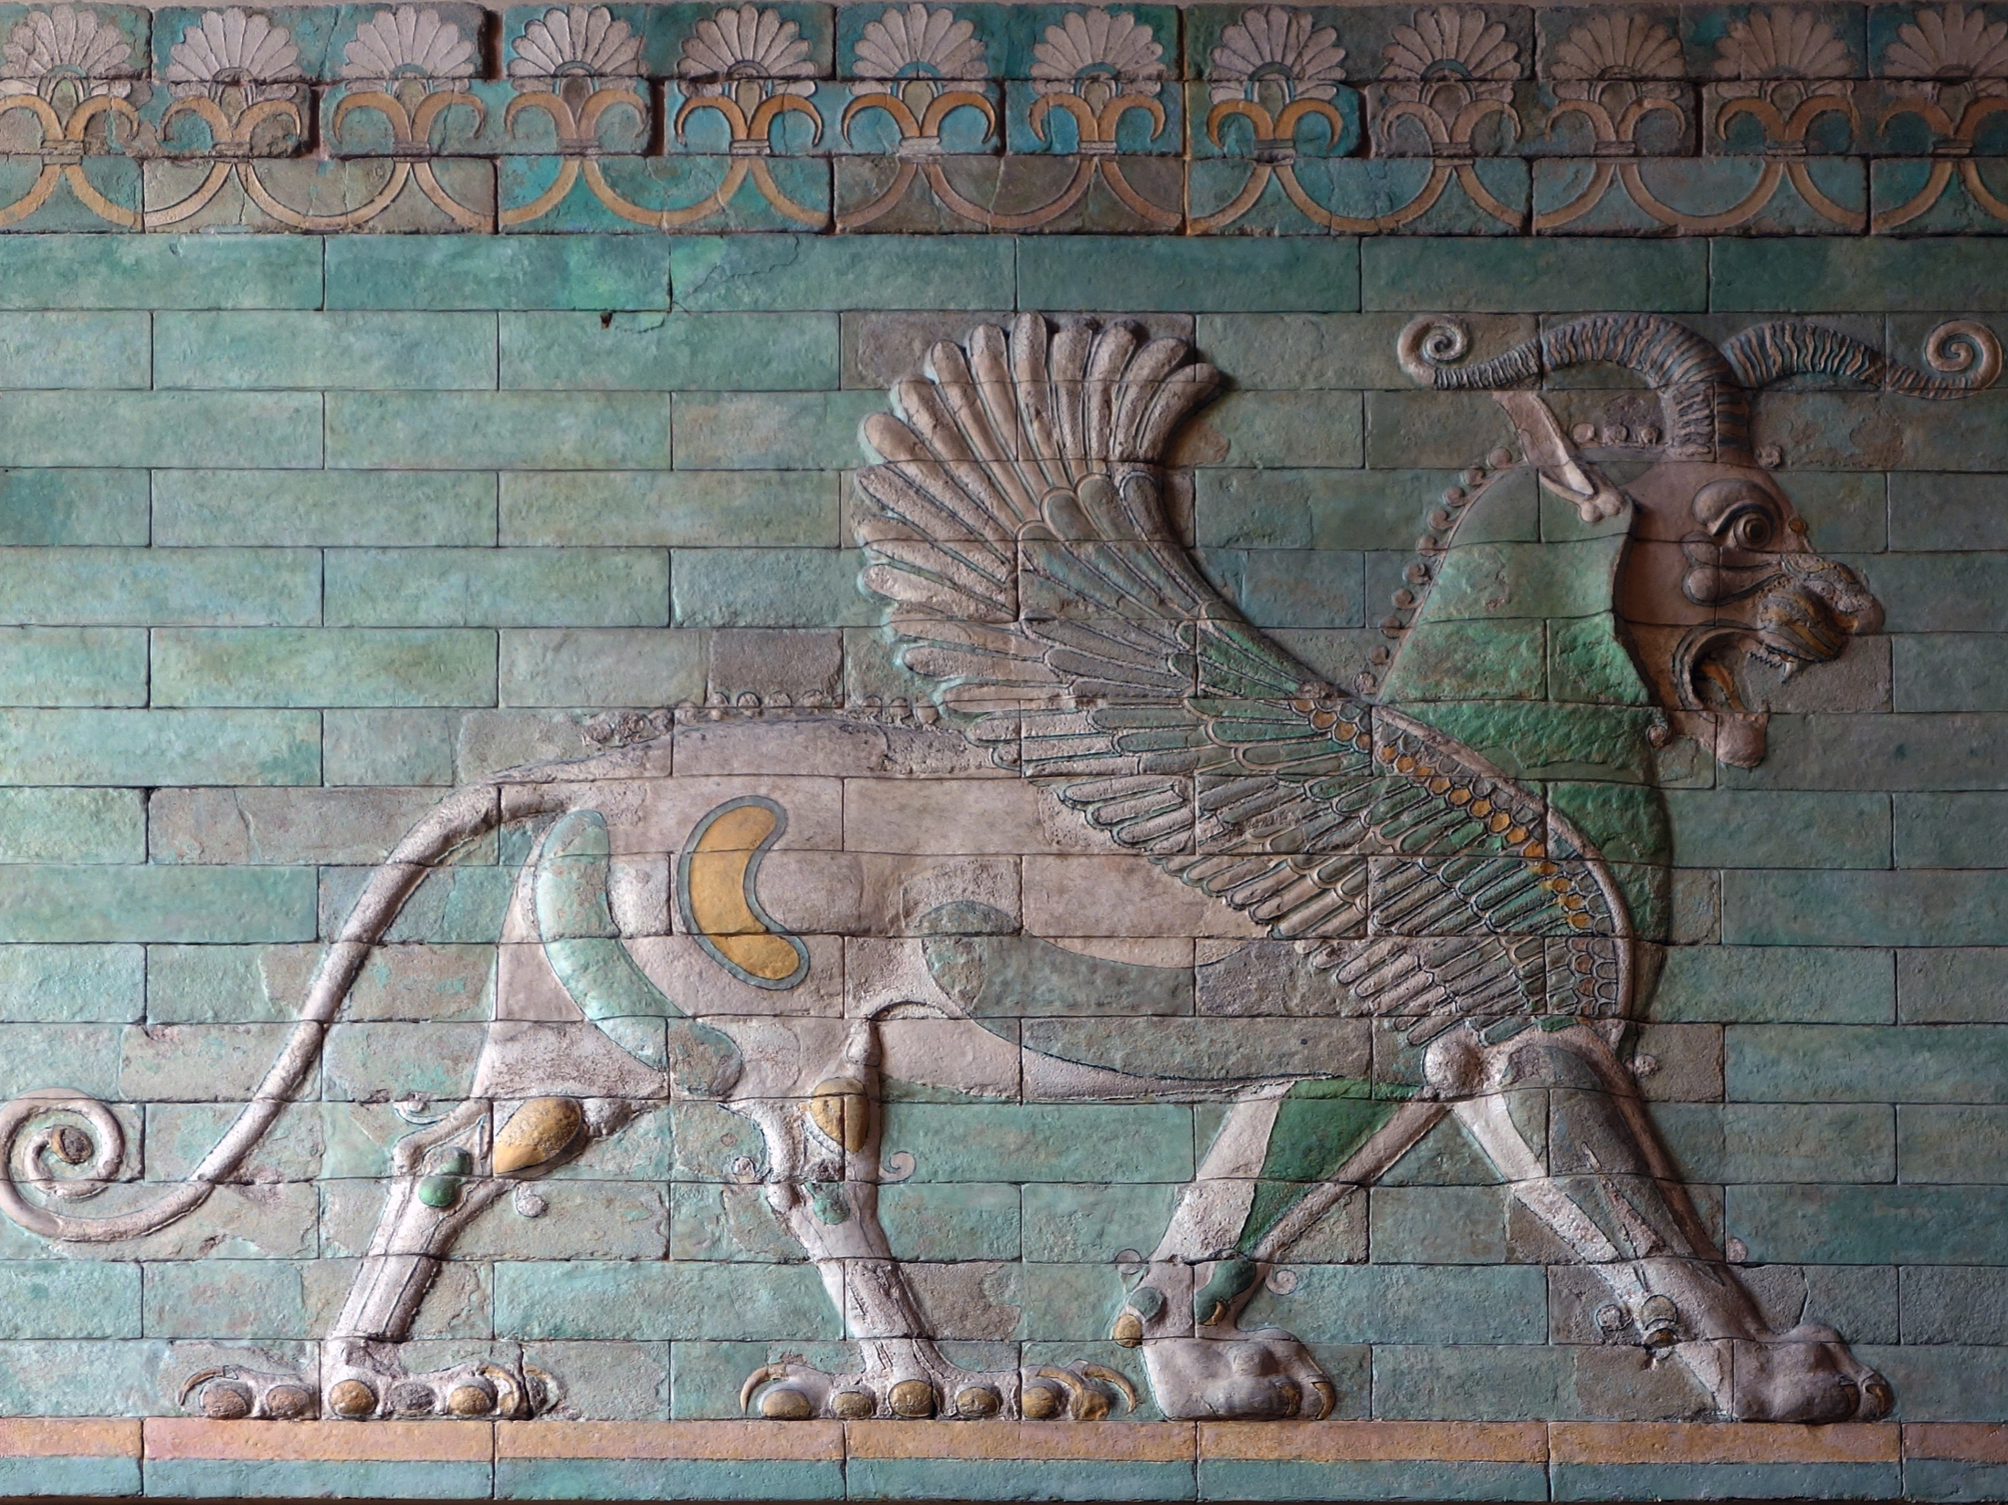
conceptual blending

Slide 7
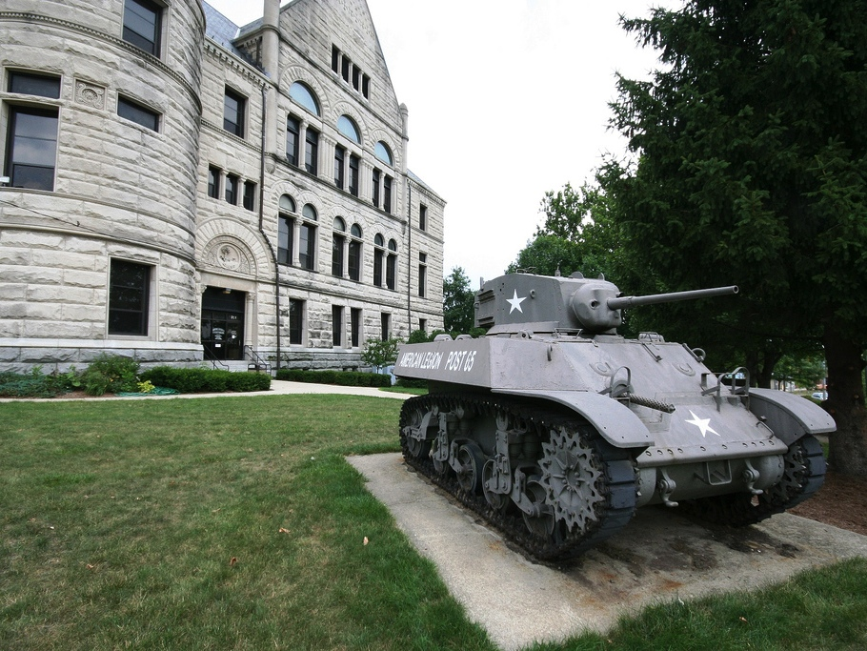
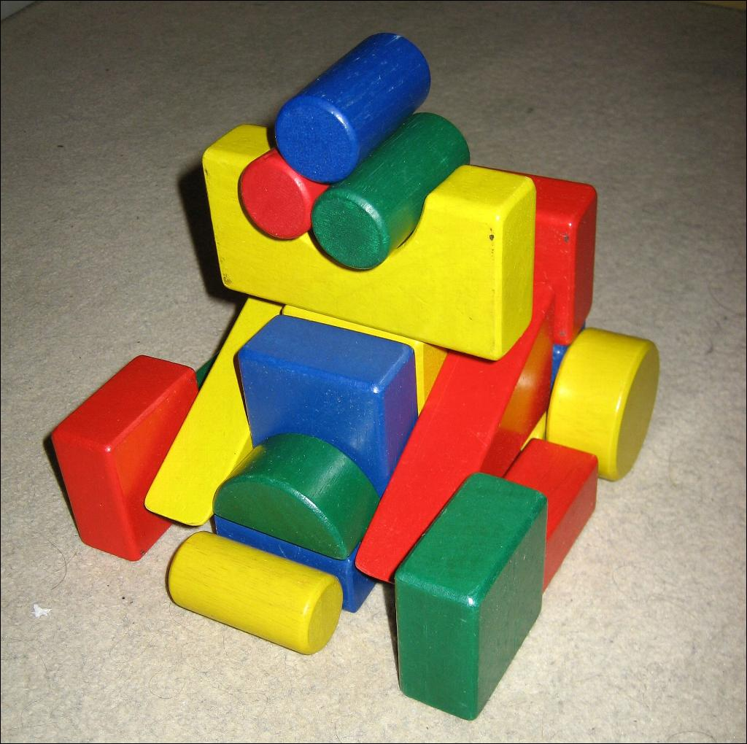
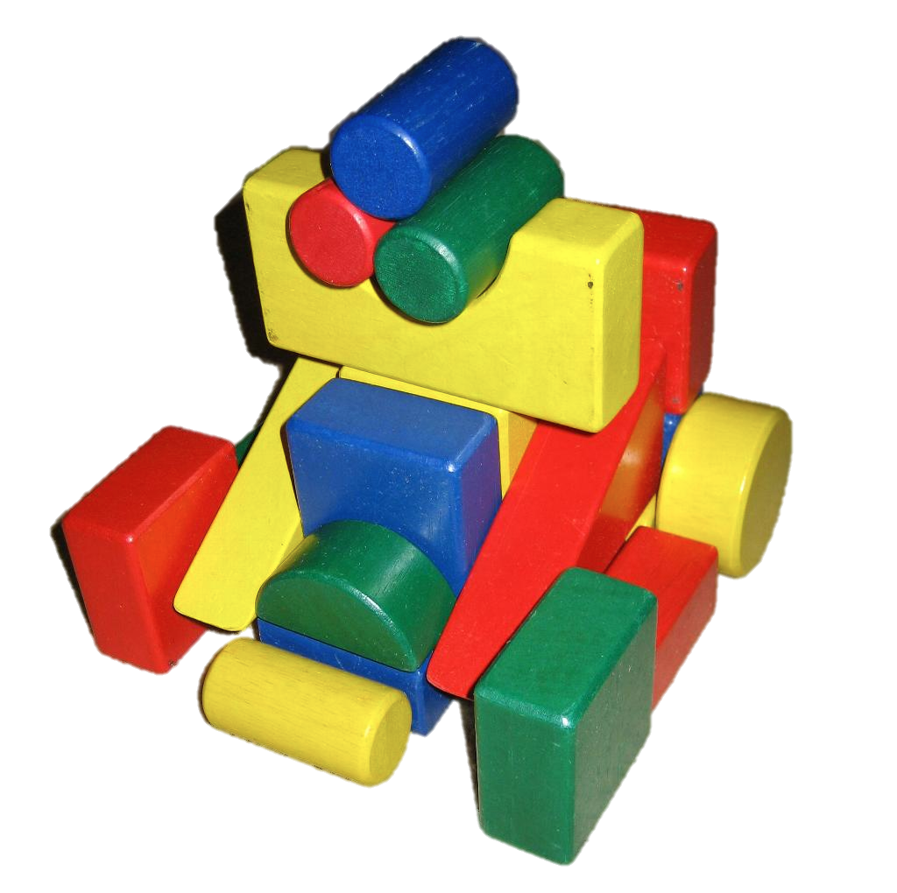
real frame
blended frame
pretend frame
object blending

Slide 8

'Family Guy'. 2014. © Fox Broadcasting Company.
script blending (video)

Slide 9
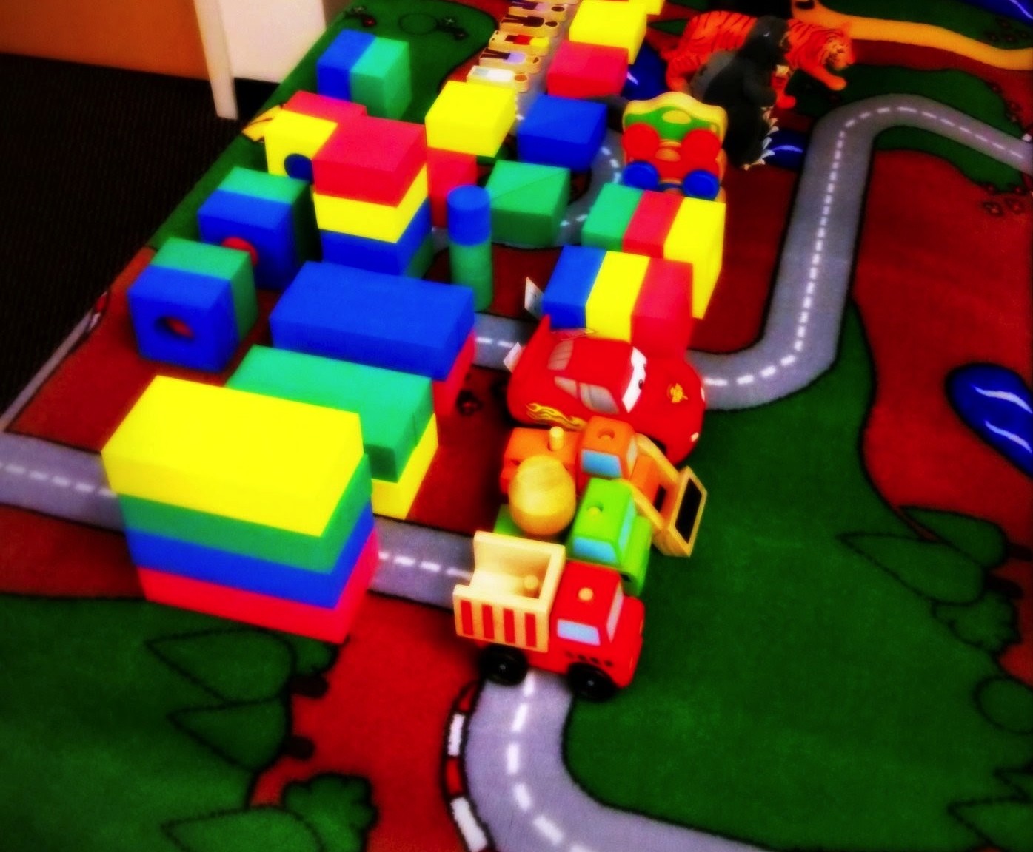
N = 22
joint play activities
play zones
negotiating shared meaning
adult dyad play study

Slide 10
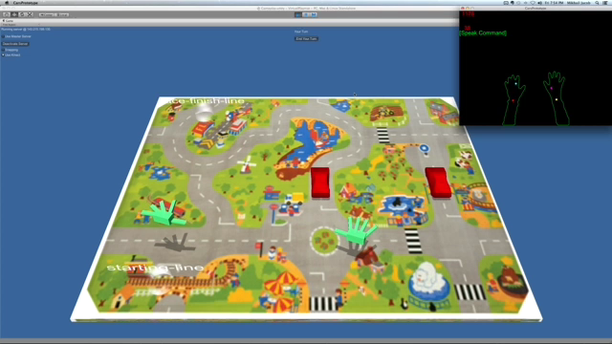
virtual play environment (video)

Slide 11
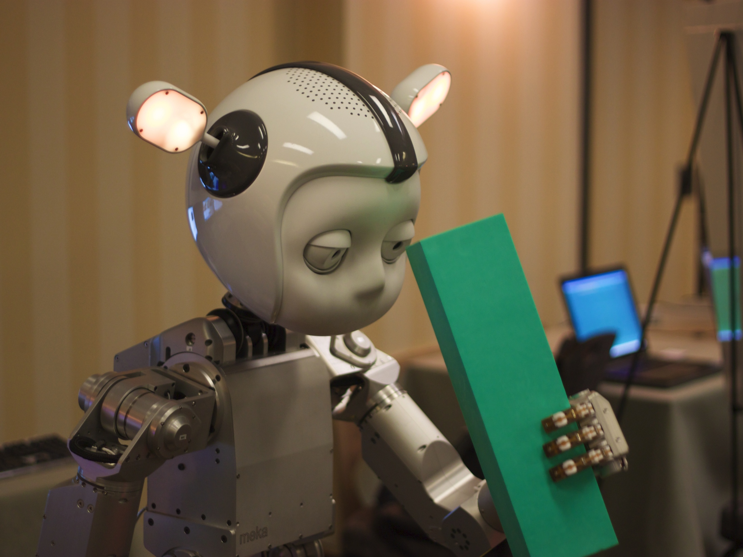
humanoid robot play
higher cognition model CoCoA
CoCoA – CADENCE integration
turn-taking model CADENCE

Slide 12
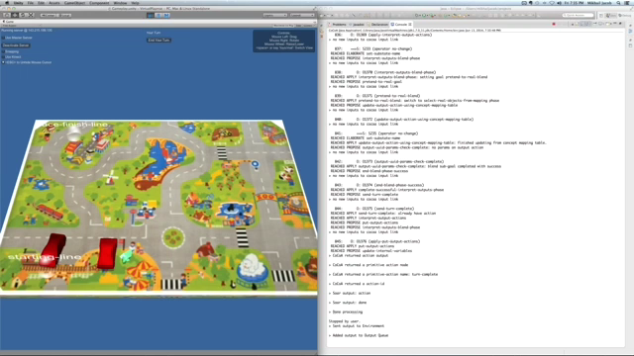
demo (video)

Slide 13

studied adult dyad toy play
instantiating CoCoA in Soar
script executing play agent
re-implementing object blending
adding script blending
virtual environment integration
nuggets

Slide 14

coals
shared mental model negotiation
CoCoA – CADENCE integration
action interpretation
soar-appropriate name
script / plan recognition
evaluation

Slide 15

mikhail.jacob@gatech.edu
mikhailjacob.in
adam.cc.gatech.edu

Slide 16
